Slide 1
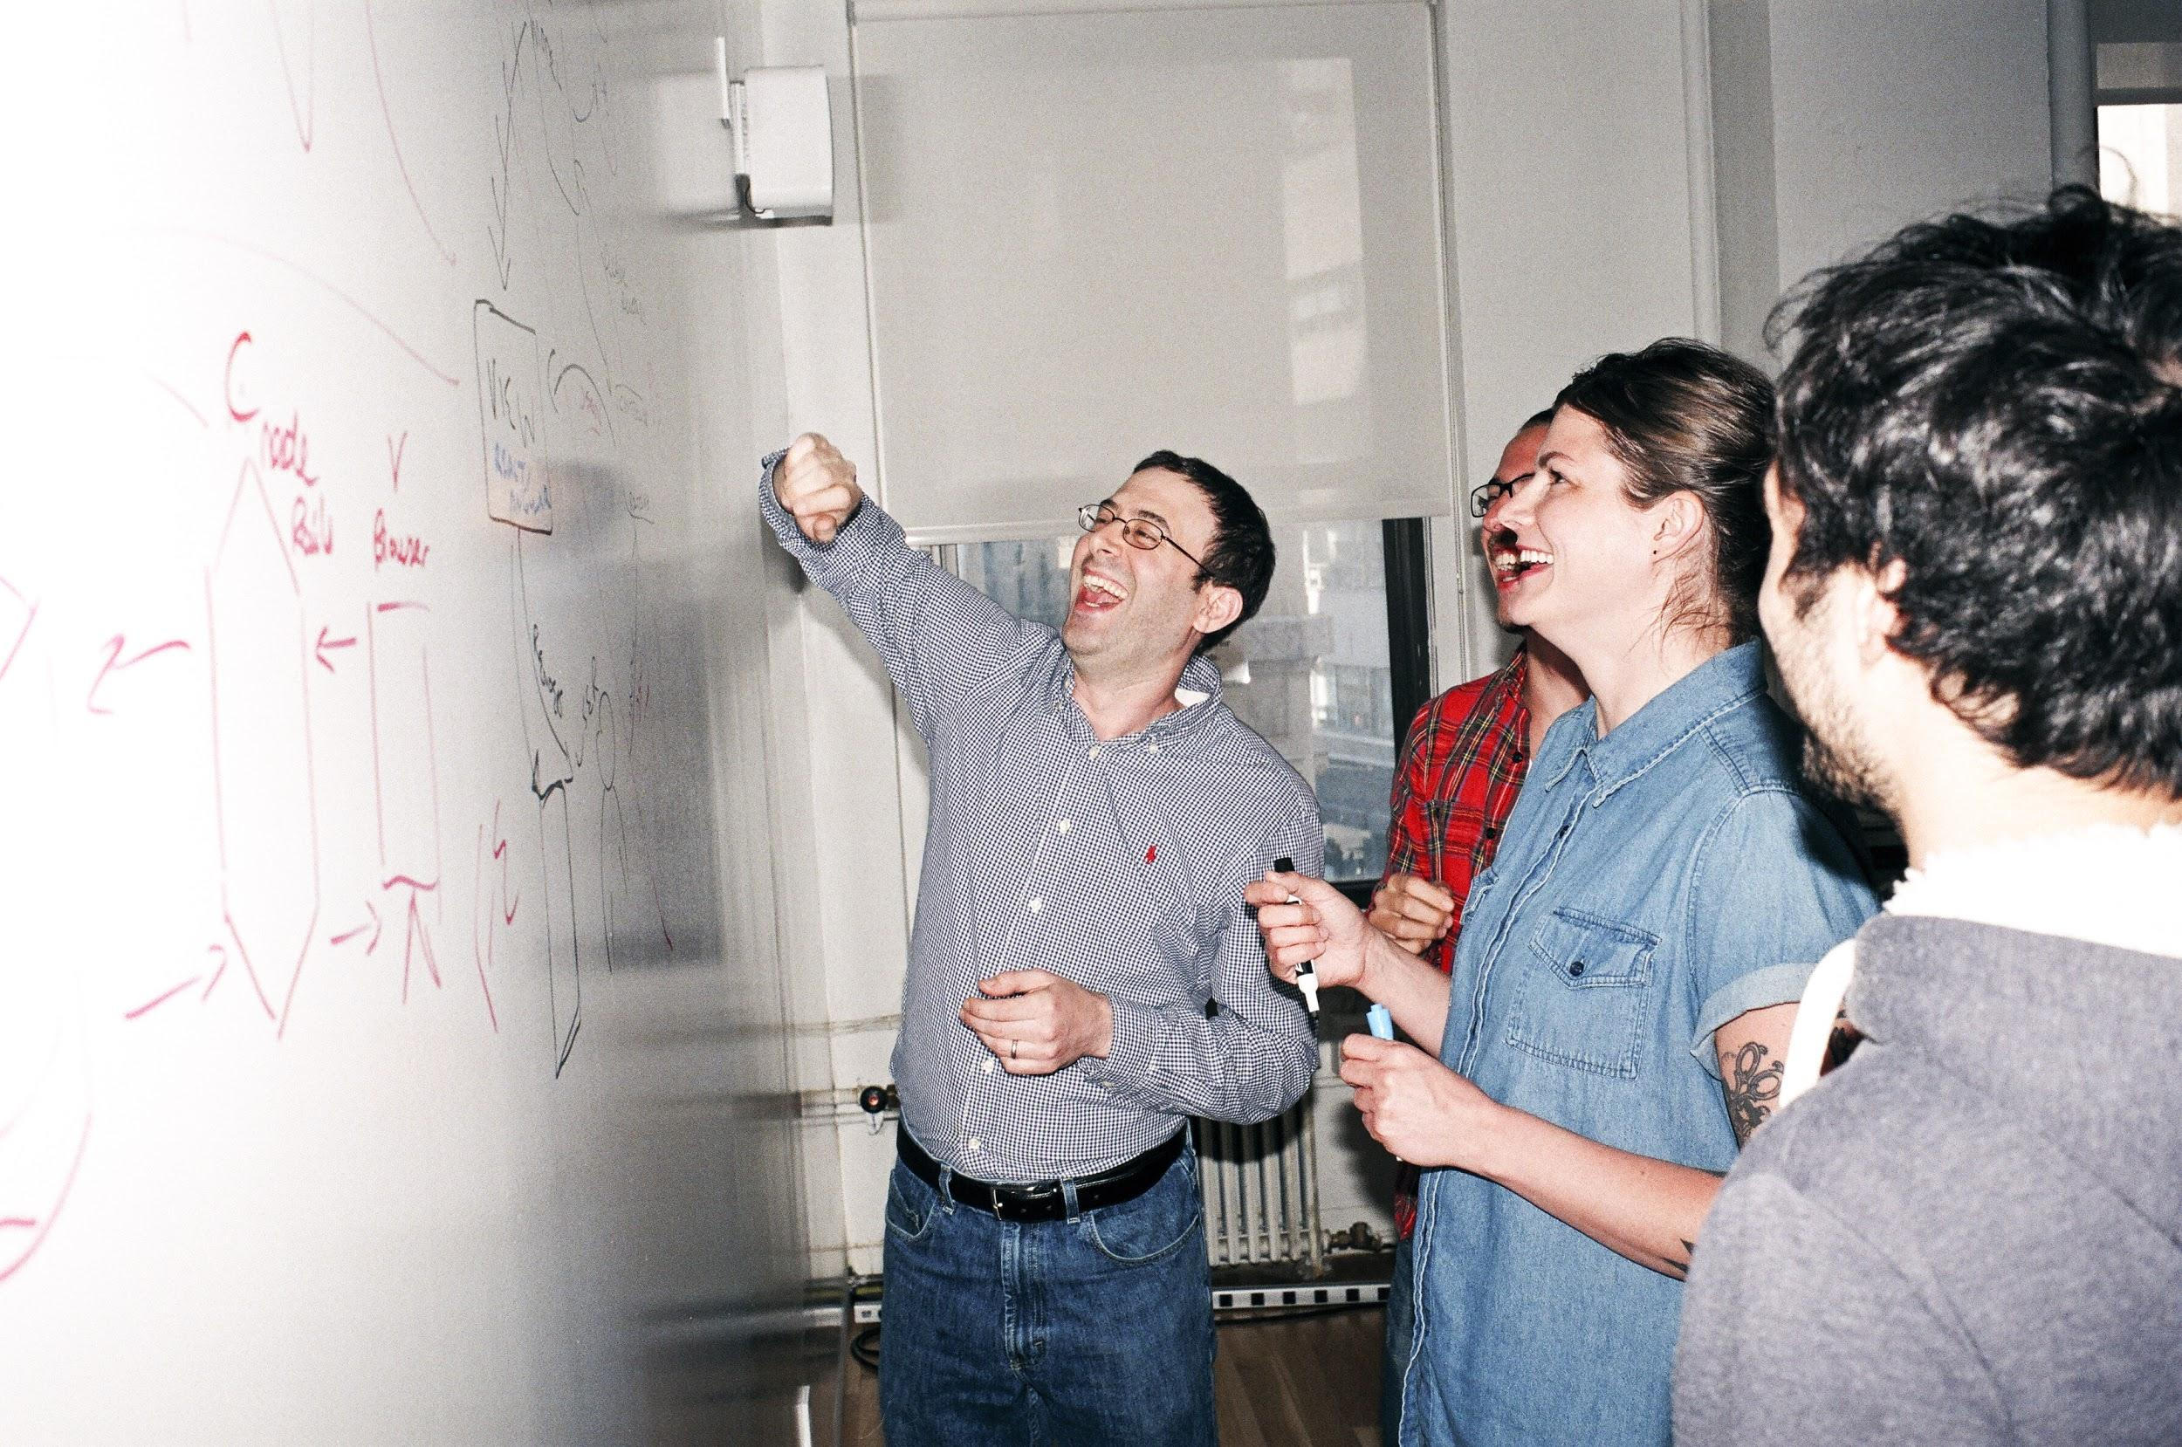

Welcome to General Assembly
WiFi GA Guest
Password yellowpencil
Notes:
[Leave this slide visible until presentation starts]

Slide 2
DATA SCIENCE
Lesson 10 - Databases and SQL

Slide 3
Course Plan
Paul & James review final project ideas

Slide 4
Git & GitHub – 1 Pager Guide!

Slide 5
AGENDA
Databases
SQL
Lab: SQL
Discussion of Data Science Productivity Tools

Slide 6
DATABASES
DATA SCIENCE PART TIME COURSE

Slide 7
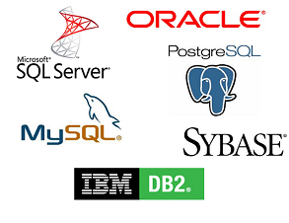
RDBMS

Slide 8
WHAT IS A DATABASE
Databases are computer systems that manage storage and querying of data. Databases provide a way to organise data along with efficient methods to retrieve specific information.
Typically, retrieval is performed using a query language, a mini programming syntax with a few basic operators for data transformation, the most common of which is SQL.

Slide 9



WHAT IS A DATABASE
Databases are the standard solution for data storage and are much more robust than text, CSV or json files. Most analyses involve pulling data to and from a resource and in most settings, that means using a database.
Databases can come in many flavours, designed to serve for different use cases.

Slide 10
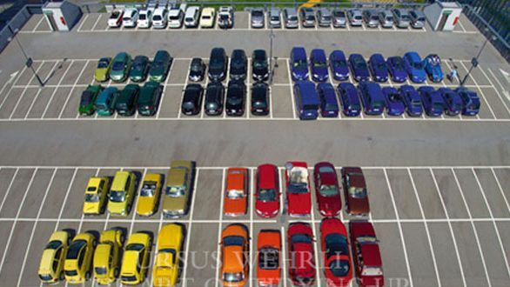
WHY USE DATABASES
Rules on structure make writing and retrieving data more reliable and efficient.
Standardised business definitions
Source of truth
Fast read
Where databases are valued:
Operational systems
Reporting

Slide 11
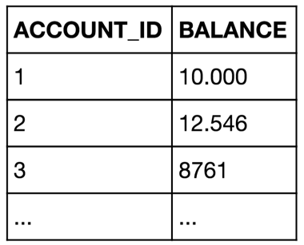
RELATIONAL DATABASE - TABLES
A relational database is a database based tabular data and links between data entities or concepts.
A relational database is organised into tables. Each table should correspond to one entity or concept.

Slide 12
RELATIONAL DATABASE - SCHEMA
A table is made up rows and columns, similar to a Pandas dataframe or Excel spreadsheet.
A table also has a schema which is a set of rules for what goes in each table. These specify what columns are contained in the table and what type those columns are (text, integers, floats, etc.).
schema
Table : BankAccounts
V1 : ACCOUNT_ID - Integer
V2 : Balance - Decimal(10,3)
Primary_Key = ACCOUNT_ID
data

Slide 13
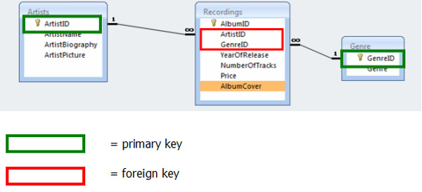
RELATIONAL DATABASE - KEYS
Each table typically has a primary key column. This column is a unique value per row and serves as the identifier for the row.
A table can have many foreign keys as well. A foreign key is a column that contains values to link the table to the other tables.

Slide 14
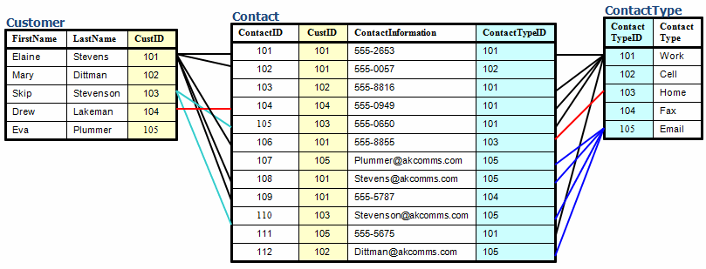
RELATIONAL DATABASE - DATA MODEL
Databases are ‘modelled’ to suit their intended purpose.

Slide 15
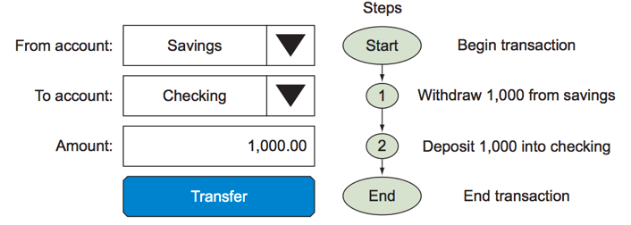
RELATIONAL DATABASE - TRANSACTIONAL INTEGRITY
A unit of work performed against a database is called a transaction. This term generally represents any change in database.
Example: Transfer money from an account to another.
What happens if step 1 succeeds and step 2 fails ?
What if you request the balance between step 1 and step2 ?

Slide 16

RELATIONAL DATABASE - ACID
ACID is a set of properties that guarantee that database transactions are processed reliably.
Atomicity "all or nothing": if one part of the transaction fails, the entire transaction fails, and the database state is left unchanged.
Consistency ensures that any transaction will bring the database from one valid state to another.
Isolation ensures that the concurrent execution of transactions results in a system state that would be obtained if transactions were executed serially, i.e., one after the other.
Durability ensures that once a transaction has been committed, it will remain so, even in the event of power loss, crashes, or errors.

Slide 17
NO-SQL Databases
DATA SCIENCE PART TIME COURSE

Slide 18
SQL/NoSQL
SQL
Traditional rows and columns data
Strict structure / Primary Keys
Entire column for each feature
Industry standard
NoSQL
No well defined data structure
Works better for unstructured data
Cheaper hardware
Popular among Startups

Slide 19
SQL/NoSQL - Examples
SQL
MySQL
Oracle
Postgres
SQLite
SQLServer
Redshift
NoSQL
MongoDB
CouchDB
Redis
Cassandra
Neo4j
HBase

Slide 20
BIG DATA & SQL
DATA SCIENCE PART TIME COURSE

Slide 21

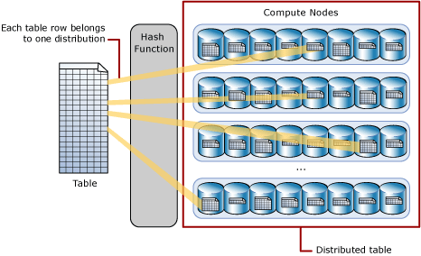



MPP RDBMS - Massively Parallel Processing

Slide 22




BIG DATA SQL
What is it?
Sign up https://community.cloud.databricks.com
Import URL https://docs.databricks.com/_static/notebooks/gentle-introduction-to-apache-spark.html

Slide 23
SQL
DATA SCIENCE PART TIME COURSE
http://rextester.com/l/sql_server_online_compiler
How to make a table?
How to query a table
How to filter data (WHERE CLAUSE)
How to Group by
Aggregations (sum, average, count)
Joins

Slide 24
SQL
Make Table:
Create table GA_SALES (
month_name nvarchar(20)
,qtr nvarchar(20)
,sales_dollars money
);
-- Insert Rows:
insert into GA_SALES values ('Jul', 'FYQ1', 20000.5);
insert into GA_SALES values ('Aug', 'FYQ1', 30000);
insert into GA_SALES values ('Sep', 'FYQ1', 40000);
Query:
select top 10 * from GA_SALES; — (limit 10)
Where Clause:
select * from GA_SALES where sales_dollars > 25000;
What Tables?
select * from information_schema.tables
Group by:
select qtr
,sum(sales_dollars) as qtr_sales
from GA_SALES
group by qtr
Aggregations:
Try - avg() or count()
Joins:
create table GA_TARGETS (
qtr nvarchar(20)
,target money
);
insert into GA_TARGETS values ('FYQ1', 100000);
insert into GA_TARGETS values ('FYQ2', 120000);
select a.qtr
,max(target) as target
,sum(sales_dollars) as qtr_sales
,max(target) - sum(sales_dollars) variance
from GA_SALES a
join GA_TARGETS b on a.qtr = b.qtr
group by a.qtr

Slide 25
LAB
DATA SCIENCE PART TIME COURSE

Slide 26
DISCUSSION:
PRODUCTIVITY TOOLS
DATA SCIENCE PART TIME COURSE

Slide 27





PRODUCTIVITY TOOLS
Workflow, collaboration, operationalising
Automatic Machine Learning - Auto ML

Slide 28
HOMEWORK
Read the following
Read Chapter 2 of http://www.redbook.io/
https://medium.com/airbnb-engineering/automated-machine-learning-a-paradigm-shift-that-accelerates-data-scientist-productivity-airbnb-f1f8a10d61f8
DATA SCIENCE

